Slide 1
Module 3: Explore non-relational data in Azure

Slide 2
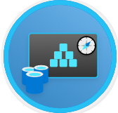

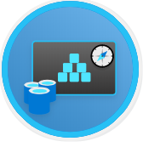
Agenda
Explore non-relational data services in Azure
Explore provisioning and deploying non-relational data services in Azure
Manage non-relational data stores in Azure

Slide 3
Lesson 1: Explore non-relational data services in Azure

Slide 4
Lesson 1 objectives
Explore use-cases and management benefits of using Azure Table storage
Explore use-cases and management benefits of using Azure Blob storage
Explore use-cases and management benefits of using Azure File storage
Explore use-cases and management benefits of using Azure Cosmos DB

Slide 5
Explore Azure Table storage
Key (Customer ID)
Value (Customer Data)
C1
AAAAA
BBB
101 Block Street
YY
999
888
C2
MM
NN
21 A Street
5 B Avenue
C3
DDD
EEE
FFF
111
222
66 C Road
Notes:
Instructor notes
All rows in a table must have a key, but apart from that the columns in each row can vary. Unlike traditional relational databases, Azure Table Storage tables have no concept of relationships, stored procedures, secondary indexes, or foreign keys. Data will usually be denormalized, with each row holding the entire data for a logical entity.

Slide 6
Explore Azure Blob storage
Block blobs
Page blobs
Append blobs
Has a maximum size of 4.7TB
Best for storing large, discrete, binary objects that changes infrequently
Each individual block can store up to 100MB of data
A block blob can contain up to 50000 blocks
Can hold up to 8TB of data
Is organized as a collection of fixed sized-512 byte pages
Used to implement virtual disk storage for virtual machines
The maximum size is just over 195GB
Is a block blob that is used to optimize append operations
Each individual block can store up to 4MB of data
Notes:
Instructor notes
Azure Blob storage is a service that enables you to store massive amounts of unstructured data, or Binary Large OBjects, in the cloud.
Azure currently supports three different types of blob:
Block blobs. A block blob is handled as a set of blocks. Each block can vary in size, up to 100 MB. A block blob can contain up to 50,000 blocks, giving a maximum size of over 4.7 TB. The block is the smallest amount of data that can be read or written as an individual unit. Block blobs are best used to store discrete, large, binary objects that change infrequently.
Page blobs. A page blob is organized as a collection of fixed size 512-byte pages. A page blob is optimized to support random read and write operations; you can fetch and store data for a single page if necessary. A page blob can hold up to 8 TB of data. Azure uses page blobs to implement virtual disk storage for virtual machines.
Append blobs. An append blob is a block blob optimized to support append operations. You can only add blocks to the end of an append blob; updating or deleting existing blocks isn't supported. Each block can vary in size, up to 4 MB. The maximum size of an append blob is just over 195 GB.

Slide 7






Explore Azure File storage
Azure File Storage creates files shares in the cloud and provides the ability to access the file shares from anywhere with an internet connection.
Uses Server Message Block 3.0 (SMB) to share files
Share up to 100 TB of data in a single storage account
Fully managed service – data is replicated locally and is encrypted at rest
File Share
Cloud Apps
On-Premises Apps
Cloud Apps

Slide 8

What is Azure Cosmos DB?
Azure Cosmos DB is a multi-model NoSQL database management system.
Cosmos DB manages data as a partitioned set of documents.
Real time access with fast read and write latencies.
Takes advantage of Azure scaling and storage capabilities.
Notes:
Relational databases store data in relational tables, but sometimes the structure imposed by this model can be too rigid, and often leads to poor performance unless you spend time implementing detailed tuning. Other models, collectively known as NoSQL databases exist. These models store data in other structures, such as documents, graphs, key-value stores, and column family stores.
Azure Cosmos DB is a multi-model NoSQL database management system.
Cosmos DB manages data as a partitioned set of documents. A document is a collection of fields, identified by a key.
The fields in each document can vary, and a field can contain child documents.
Many document databases use JSON (JavaScript Object Notation) to represent the document structure.
In this format, the fields in a document are enclosed between braces, { and }, and each field is prefixed with its name.
A document can hold up to 2 MB of data, including small binary objects.
If you need to store larger blobs as part of a document, use Azure Blob storage, and add a reference to the blob in the document.
Documents in a Cosmos DB database are organized into containers.
The documents in a container are grouped together into partitions. A partition holds a set of documents that share a common partition key.
You designate one of the fields in your documents as the partition key.
You should select a partition key that collects all related documents together.
This approach helps to reduce the amount of I/O (disk reads) that queries might need to perform when retrieving a set of documents for a given entity.
For example, in a document database for an ecommerce system recording the details of customers and the orders they've placed, you could partition the data by customer ID, and store the customer and order details for each customer in the same partition.
To find all the information and orders for a customer, you simply need to query that single partition.
There's a superficial similarity between a Cosmos DB container and a table in Azure Table storage: in both cases, data is partitioned and documents (rows in a table) are identified by a unique ID within a partition.
However, the similarity ends there. Unlike Azure Table storage, documents in a Cosmos DB partition aren't sorted by ID.
Instead, Cosmos DB maintains a separate index. This index contains not only the document IDs, but also tracks the value of every other field in each document.
This index is created and maintained automatically.
This index enables you to perform queries that specify criteria referencing any fields in a container, without incurring the need to scan the entire partition to find that data.

Slide 9
Use cases for Azure Cosmos DB
Web and retail
Gaming
IoT scenarios
Using Azure Cosmos DB’s multi-master replication model along with Microsoft’s performance commitments, Data Engineers can implement a data architecture to support web and mobile applications that achieve less than a 10-ms response time anywhere in the world
The database tier is a crucial component of gaming applications. Modern games perform graphical processing on mobile/console clients but rely on the cloud to deliver customized and personalized content like in-game stats, social media integration, and high-score leader boards
Hundreds of thousands of devices have been designed and sold to generate sensor data known as Internet of Things (IoT) devices. Using technologies like Azure IoT Hub, Data Engineers can easily design a data solution architecture that captures real-time data. Cosmos DB can accept and store this information very quickly
Notes:
Instructor notes
Use cases and management benefits of using Azure Cosmos DB
Cosmos DB is a highly scalable database management system. Each partition can grow up to 10 GB in size.
Indexes are created and maintained automatically.
All databases are replicated within a single region (or across regions at additional cost)
Cosmos DB guarantees 99.99% high availability.
Cosmos DB guarantees less than 10-ms latencies for both reads (indexed) and writes at the 99th percentile, all around the world.
Cosmos DB is highly suitable for the following scenarios:
- IoT and telematics - Retail and marketing
Gaming
Web and mobile applications

Slide 10
Lesson 1: Knowledge check (continued on next slide)
What are the elements of an Azure Table storage key?
Table name and column name
Partition key and row key
Row number
When should you use a block blob, and when should you use a page blob?
Use a block blob for unstructured data that requires random access to perform reads and writes. Use a page blob for discrete objects that rarely change.
Use a block blob for active data stored using the Hot data access tier, and a page blob for data stored using the Cool or Archive data access tiers
Use a page block for blobs that require random read and write access. Use a block blob for discrete objects that change infrequently
Why might you use Azure File storage?
To share files that are stored on-premises with users located at other sites
To enable users at different sites to share files
To store large binary data files containing images or other unstructured data

Slide 11
Lesson 1: Knowledge check (continued)
You are building a system that monitors the temperature throughout a set of office blocks, and sets the air conditioning in each room in each block to maintain a pleasant ambient temperature. Your system has to manage the air conditioning in several thousand buildings spread across the country/region, and each building typically contains at least 100 air-conditioned rooms. What type of NoSQL data store is most appropriate for capturing the temperature data to enable it to be processed quickly?
Send the data to an Azure Cosmos DB database and use Azure Functions to process the data
Store the data in a file stored in a share created using Azure File Storage
Write the temperatures to a blob in Azure Blob storage

Slide 12
Lesson 2: Explore provisioning and deploying non-relational data services in Azure

Slide 13
Lesson 2 objectives
Provision non-relational data services
Configure non-relational data services
Explore basic connectivity issues
Explore data security components
Notes:
Instructor notes
Ensure that all of your students fully understand the components and processes involved. This will be the focus of the module.

Slide 14
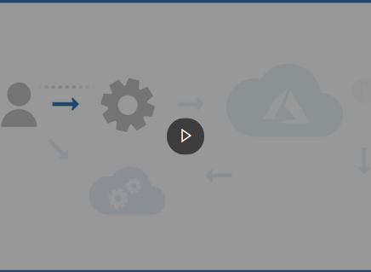
Demo: What is provisioning?
This video summarizes the process that Azure performs when you provision a service
Notes:
Instructor notes
NOTE: this demo is duplicated in Module 2 Lesson 2 so can skip this demo if already used.
Link: https://www.microsoft.com/videoplayer/embed/RE4zTud

Slide 15
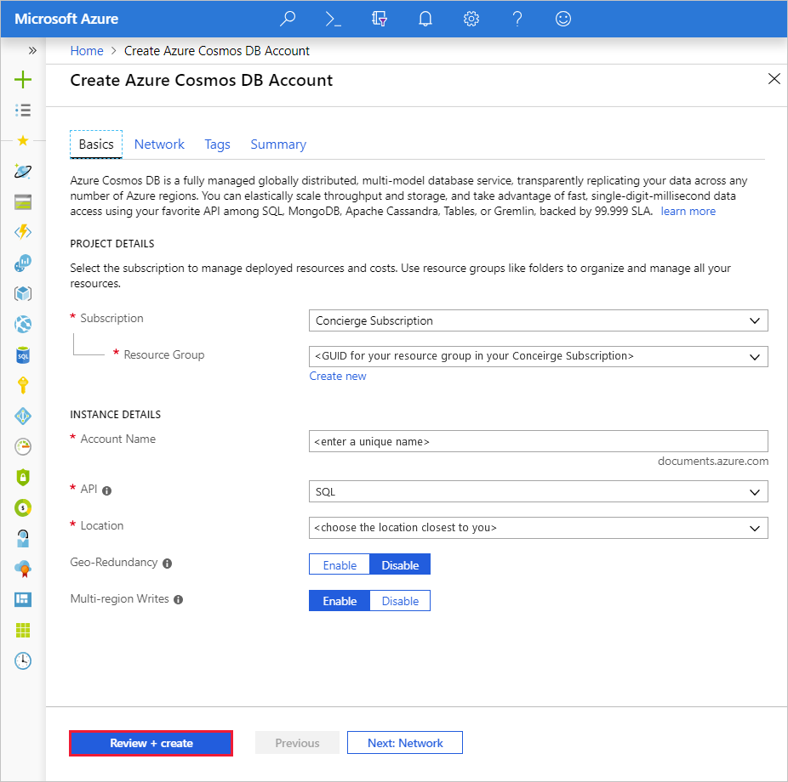
Provisioning Cosmos DB
Notes:
Instructor notes
You can provision a Cosmos DB account interactively using the Azure portal, or you can perform this task programmatically through the Azure CLI, Azure PowerShell, or an Azure Resource Manager template.

Slide 16
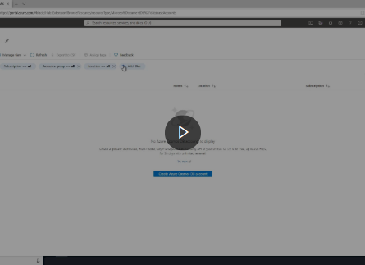
Demo: How to provision a Cosmos DB account
You can provision a Cosmos DB account interactively using the Azure portal, or you can perform this task programmatically through the Azure CLI, Azure PowerShell, or an Azure Resource Manager template. This video describes how to use the Azure portal
Notes:
Instructor notes
Link: https://www.microsoft.com/videoplayer/embed/RE4AwNK

Slide 17
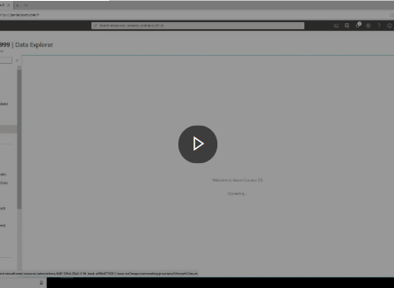
Demo
Use the Azure portal to create a database and container
Notes:
Instructor notes
Link: https://www.microsoft.com/videoplayer/embed/RE4AkhH

Slide 18
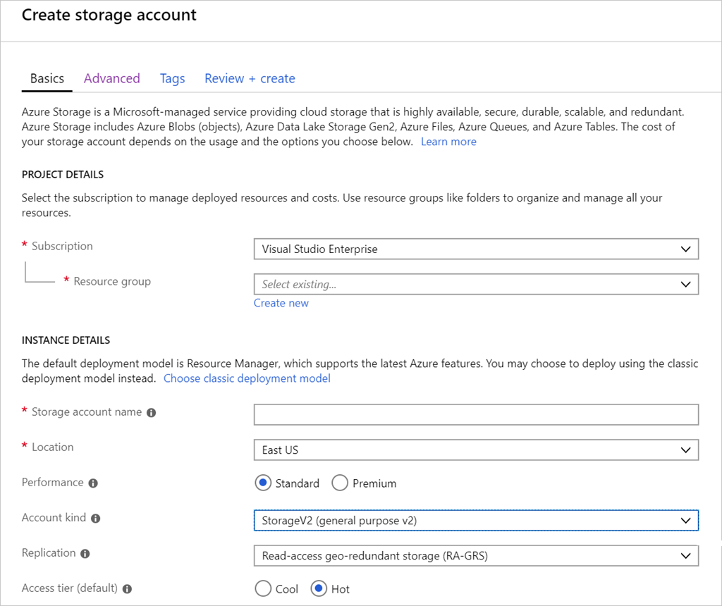
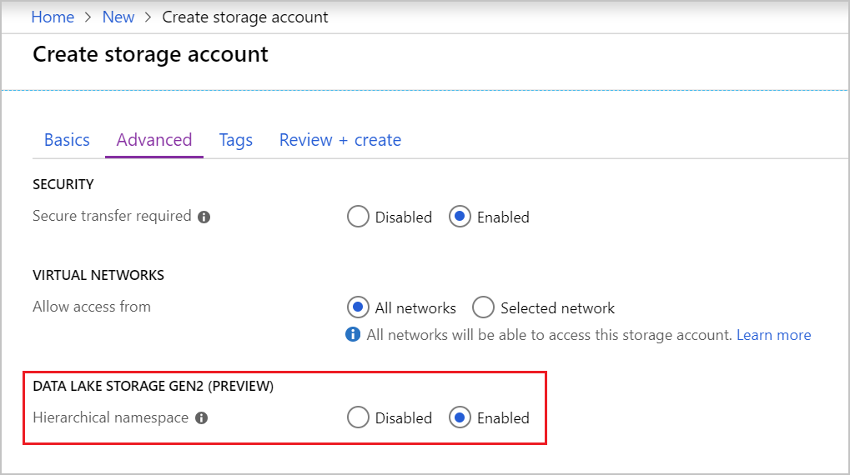
Provisioning Data Lake storage
Notes:
Instructor notes
IMPORTANT: If you're provisioning a Data Lake storage, you must specify the appropriate configuration settings when you create the storage account. You can't configure Data Lake storage after the storage account has been set up.
In the Azure portal, on the Advanced tab of the Create storage account page, in the Data Lake Storage Gen2 section, select Enabled for the Hierarchical namespace option.
After the storage account has been created, you can add one or more Data Lake Storage containers to the account. Each container supports a directory structure for storing Data Lake files.

Slide 19
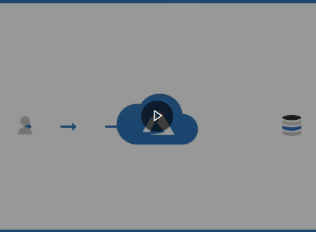
Demo: Azure authentication
Azure AD is a separate Azure service. You add users and other security principals (such as an application) to a security domain managed by Azure AD. This video describes how authentication works with Azure
Notes:
Instructor notes
Link: https://www.microsoft.com/videoplayer/embed/RE4A94T

Slide 20
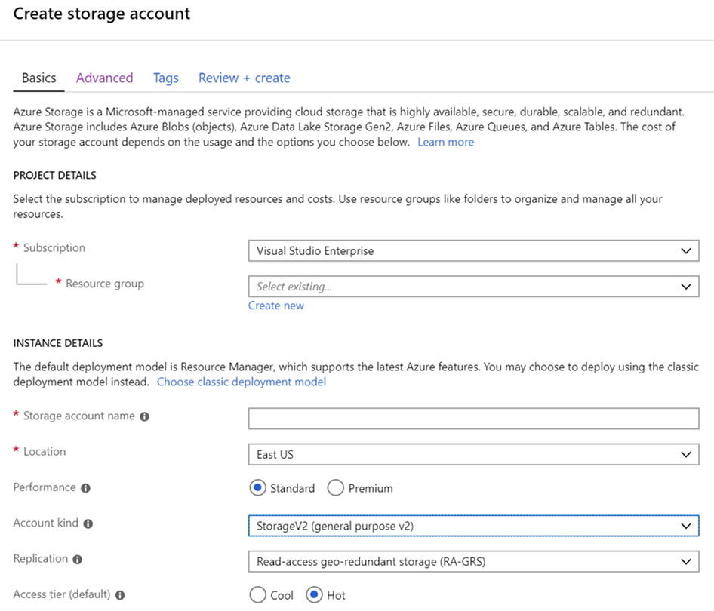
Configure storage accounts
Notes:
Instructor notes
The Configuration page for a storage account enables you to modify some general settings of the account. You can:
- Enable or disable secure communications with the service. By default, all requests and responses are encrypted by using the HTTPS protocol as they traverse the Internet. You can disable encryption if required, although this isn't recommended.
- Switch the default access tier between Cool and Hot.
- Change the way in which the account is replicated.
- Enable or disable integration with Azure AD for requests that access file shares.
Other options, such as the account kind and performance tier, are displayed on this page for information only; you can't change them.

Slide 21
Lesson 2: Knowledge check
What is provisioning?
The act of running series of tasks that a service provider performs to create and configure a service
Providing other users access to an existing service
Tuning a service to improve performance
What is a security principal?
A named collection of permissions that can be granted to a service, such as the ability to use the service to read, write, and delete data. In Azure, examples include Owner and Contributor.
A set of resources managed by a service to which you can grant access
An object that represents a user, group, service, or managed identity that is requesting access to Azure resources
Which of the following is an advantage of using multi-region replication with Cosmos DB?
Data will always be consistent in every region
Availability is increased
Increased security for your data

Slide 22

Lesson 3: Manage non-relational data stores in Azure

Slide 23

Lesson 3 objectives
Upload data to a Cosmos DB database, and learn how to query this data
Upload and download data in an Azure Storage account
Notes:
Instructor notes
Ensure that all of your students fully understand the components and processes involved. This will be the focus of the module.

Slide 24
Cosmos DB APIs
SQL API
MongoDB API
Cassandra API
Gremlin API
Table API
Notes:
Cosmos DB also provides other APIs that enable you to access these documents using the command sets of other NoSQL database management systems.
These APIs are:
Table API. This interface enables you to use the Azure Table Storage API to store and retrieve documents. The purpose of this interface is to enable you to switch from Table Storage to Cosmos DB without requiring that you modify your existing applications.
MongoDB API. MongoDB is another well-known document database, with its own programmatic interface. Many organizations use on-premises. You can use the MongoDB API for Cosmos DB to enable a MongoDB application to run unchanged against a Cosmos DB database. You can migrate the data in the MongoDB database to Cosmos DB running in the cloud, but continue to run your existing applications to access this data.
Cassandra API. Cassandra is a column family database management system. This is another database management system that many organizations run on-premises. The Cassandra API for Cosmos DB provides a Cassandra-like programmatic interface for Cosmos DB. Cassandra API requests are mapped to Cosmos DB document requests. As with the MongoDB API, the primary purpose of the Cassandra API is to enable you to quickly migrate Cassandra databases and applications to Cosmos DB.
Gremlin API. The Gremlin API implements a graph database interface to Cosmos DB. A graph is a collection of data objects and directed relationships. Data is still held as a set of documents in Cosmos DB, but the Gremlin API enables you to perform graph queries over the data. Using the Gremlin API you can walk through the objects and relationships in the graph to discover all manner of complex relationships, such as "What is the name of the pet of Sam's landlord?“.
The principal use of the Table, MongoDB, and Cassandra APIs is to support existing applications written using these data stores. If you're building a new application and database, you should use the SQL API or Gremlin API.

Slide 25
Load data using the Cosmos DB Migration tool
You can use the Data Migration tool to import data to Azure Cosmos DB from a variety of sources, including:
JSON files
MongoDB
SQL Server
CSV files
Azure Table storage
Amazon DynamoDB
HBase
Azure Cosmos containers
Notes:
Instructor notes
The Data Migration tool is available as a download (https://aka.ms/csdmtool).
The tool guides you through the process of migrating data into a Cosmos DB database. You're prompted for the source of the data (one of the items listed above), and the destination (the Cosmos DB database and container).
The tool can either populate an existing container, or create a new one if the specified container doesn't already exist.
NOTE: You can also use the Data Migration tool to export data from a Cosmos DB container to a JSON file, either held locally or in Azure Blob storage

Slide 26
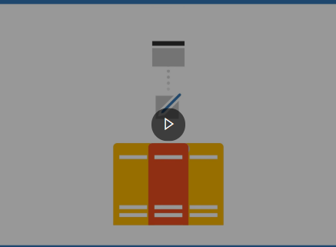
Demo: Configure consistency
Within a single region, Cosmos DB uses a cluster of servers. This approach helps to improve scalability and availability. A copy of all data is held in each server in the cluster. This video explains how this works, and the effects it can have on consistency
Notes:
Instructor notes
Link: https://www.microsoft.com/videoplayer/embed/RE4AbG9

Slide 27
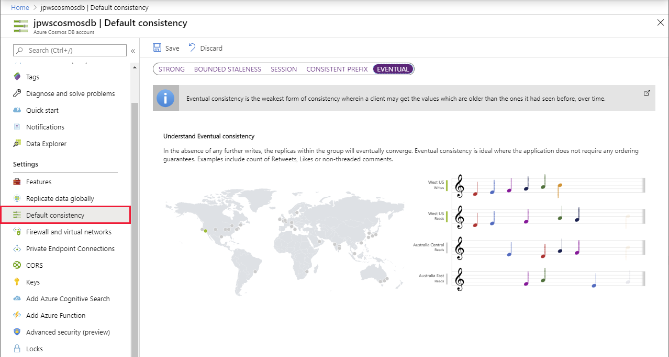
Consistency in Azure Cosmos DB
Notes:
Cosmos DB enables you to specify how such inconsistencies should be handled. It provides the following options:
Eventual. This option is the least consistent. It's based on the situation just described. Changes won't be lost, they'll appear eventually, but they might not appear immediately. Additionally, if an application makes several changes, some of those changes might be immediately visible, but others might be delayed; changes could appear out of order.
Consistent Prefix. This option ensures that changes will appear in order, although there may be a delay before they become visible. In this period, applications may see old data.
Session. If an application makes a number of changes, they'll all be visible to that application, and in order. Other applications may see old data, although any changes will appear in order, as they did for the Consistent Prefix option. This form of consistency is sometimes known as read your own writes.
Bounded Staleness. There's a lag between writing and then reading the updated data. You specify this staleness either as a period of time, or number of previous versions the data will be inconsistent for.
Strong: In this case, all writes are only visible to clients after the changes are confirmed as written successfully to all replicas. This option is unavailable if you need to distribute your data across multiple global regions.

Slide 28
Query Azure Cosmos DB
COUNT( <fields_to_count> )
SUM( <numeric_fields> )
AVG( <numeric_fields> )
MAX( <numeric_fields> )
MIN( <numeric_fields> )
Aggregation Function Basics
SQL API examples
SELECT COUNT(*) FROM Products p
SELECT SUM(p.quantity) FROM Products p
WHERE p.expired = 0
SELECT AVG(p.price) AS ‘Average Price’
FROM Products p
SELECT p1.ID, p.Name, p1.Description, p1.Price FROM Products p1
WHERE p1.Price = (SELECT MIN(p2.Price) FROM Product p2)
Notes:
Instructor notes
Understand aggregate functions
You can use aggregate functions to summarize data in SELECT queries; you place aggregate functions in the SELECT clause. The SQL API query language supports the following aggregate functions:
COUNT(p). This function returns a count of the number of instances of field p in the result set. To count all the items in the result set, set p to a scalar value, such as 1.
SUM(p). This function returns the sum of all the instances of field p in the result set. The values of p must be numeric.
AVG(p). This function returns the mathematical mean of all the instances of field p in the result set. The values of p must be numeric.
MAX(p). This function returns the maximum value of field p in the result set.
MIN(p). This function returns the minimum value of field p in the result set.
Although the syntax of aggregate functions is similar to ANSI SQL, unlike ANSI SQL the SQL API query language doesn't support the GROUP BY clause; you can't generate subtotals for different values of the same field in a single query. You're able to include more than one aggregate function in the SELECT clause of your queries.
[Demo with the Volcanoes Data]
// Find the total number of volcanoes in Japan
SELECT COUNT(v) AS totalVolcanoesJapan
FROM v
WHERE v.Region = "Japan“
// Find the deepest volcano in Japan
SELECT MAX(v.Elevation) AS deepestVolcanoJapan
FROM v
WHERE v.Region = "Japan"

Slide 29
Lab: Upload, download, and query data in a non-relational data store
Go to the exercise Upload, download, and query data in a non-relational data store module on Microsoft Learn, and follow the instructions in the module
Notes:
Link: https://docs.microsoft.com/en-us/learn/modules/explore-non-relational-data-stores-azure/6-exercise
Instructor notes
In the sample scenario, suppose that you've created the following data stores:
A Cosmos DB for holding information about the products that Contoso manufactures.
A blob container in Azure Storage for holding the images of products.
A file share, in the same Azure Storage account, for holding product documentation.
In this exercise, you'll upload data to these data stores. You'll run queries against the data in the Cosmos DB database. Finally, you'll download and view the images and documents held in Azure Storage.
You'll perform this exercise using the Azure portal and the command line.

Slide 30
Closing slide

